Slide 1






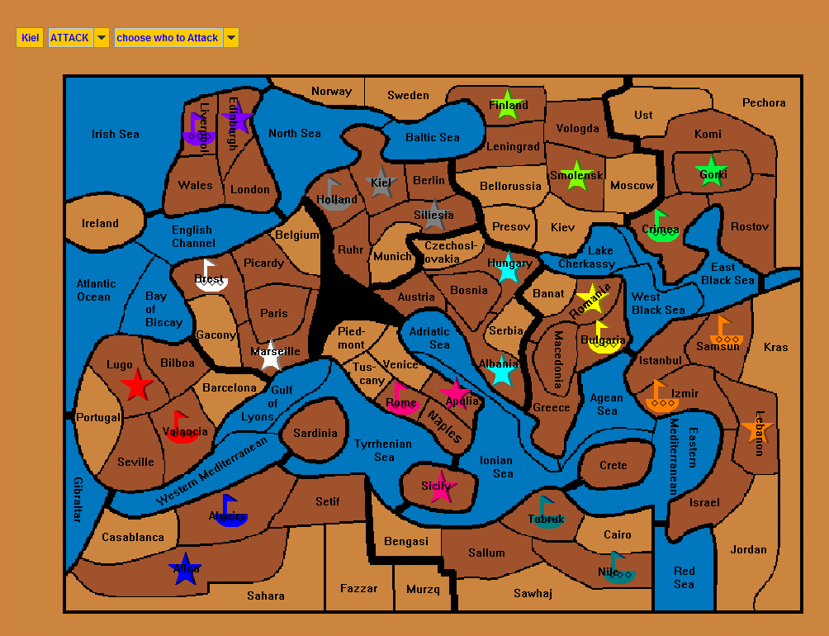


Diplomacy
Hugh McGough
Computer Science, Roosevelt High School, Seattle, WA
Description
CODE STRUCTURE & DATA STRUCTURES
CHALLENGES
This is a board game that focuses on skill and diplomacy rather than luck or brute force. There are a total of twelve teams scrambling for total domination, in order to come out on top teams need to form coalitions with each other. But in the scramble for total domination who can you trust? Forming a coalition with others could leave you vulnerable to your “allies” if they choose to double cross you.
Features of this game include a no luck based combat system where you need more man power than who you are attacking, with only one unit allowed per territory positioning is key in this game, with only a bank of 50 units available to share between the 12 teams, it becomes quickly apparent that teams need to work together to overpower their opponents. All turns are taken simultaneously in order to maximize the element of surprise and to maximize the simplicity of teamwork in this game.
A foreseen challenge of this game is creating a loop that can iterate through all of the commands and figure out which commands succeed and which one fails because all commands are executed simultaneously. If a unit is attacked its attack is canceled but creating a system that can catch if there is a loop of attacks (A attacks B, B attacks C, C attacks A) may be difficult to identify in my program. Also properly testing the logic for %100 accuracy will be time consuming. Creating a system for removing and adding units will also be tough to do in a neat and simple way.
Map
Graphics
Update
Order Resolver
Inputs
Displays to Map
Displays to Map
Order
Constants and Data Variables
Country
Action
Input Banner
Creates
If it is a scoring country
What land type it is
Which team occupies it
Which unit type occupies it
The coordinates of the country on the map
Its bordering countries or territories
Displays to Banner
Reads Data Fields
Display to Banner
WORK PROCESS
Data Field
Input Type
Submit Orders
I had to first build the Map and the Country class in order to even be able to start creating the input system. After I created the basic Map and Country classes I began to work on the input system. As it grew I needed to add methods to the country class the would return the proper items that could be inputted. Simply put I started with small classes and as more classes got added I added the necessary methods to the correct classes. After I create the input system and finish the logic to resolve all of the commands, I will add some nice features to the game such as saving games or a server.
Target Users
Border
Creates Input
Students
Teachers
Friends (that don’t want to be friends anymore ;)
People that like strategy games like chess
How this helps the target user:
This game closely models the strategy and diplomacy that took place during World War 1, this game has been played in history classes before and this program would only expedite the process of playing this game for teachers and students. Traditionally the teacher would take all of the orders of the 40 to 50 units and manually labor through all of the commands and resolve them one by one. This process can take 10 minutes or more; if you do the math, students only get 4 to 5 turns per class period. With so few turns taken per day and only a few days to spend on this game in class, few games usually end with one team as the victor. The aid of a computer program would instantly resolve all of the commands and display them all in a simple and clean style, thus optimizing the classroom experience, and time taken to play this game. The simple input system would also optimize peoples’ use of their turn to reduce invalid commands being entered which does happen more than you would think.
People who like strategy games would easily love this game and with 12 teams it would be easy to use this as a platform to meet other people. But be wary, because this game is world famous for ruining peoples friendships with a single backstab.
Input Type
WHAT’S NEXT
Some long term goals for this project would be to create a server and a complete menu with settings and save options, as well as adding some complicated features to the game like air strikes or changing units from a navy to an army. Basically adding a lot of features to make it look nicer.
PROJECT TAGLINE
Diplomacy – when war isn’t good enough

